Slide 1

PSIA: AN AL-HADI SCHOOL LEGACY

Slide 2
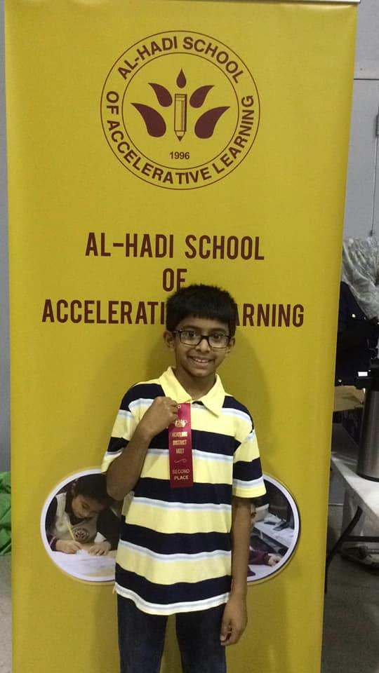
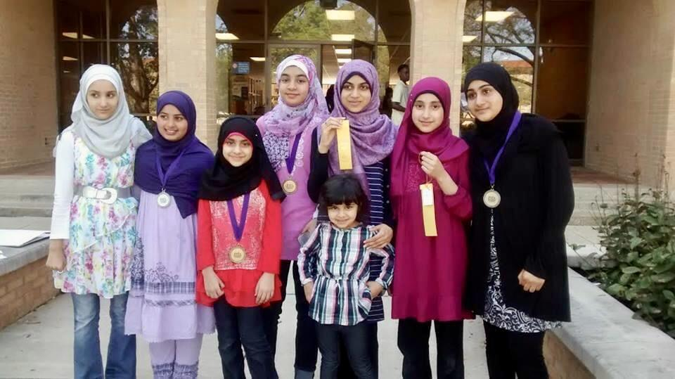
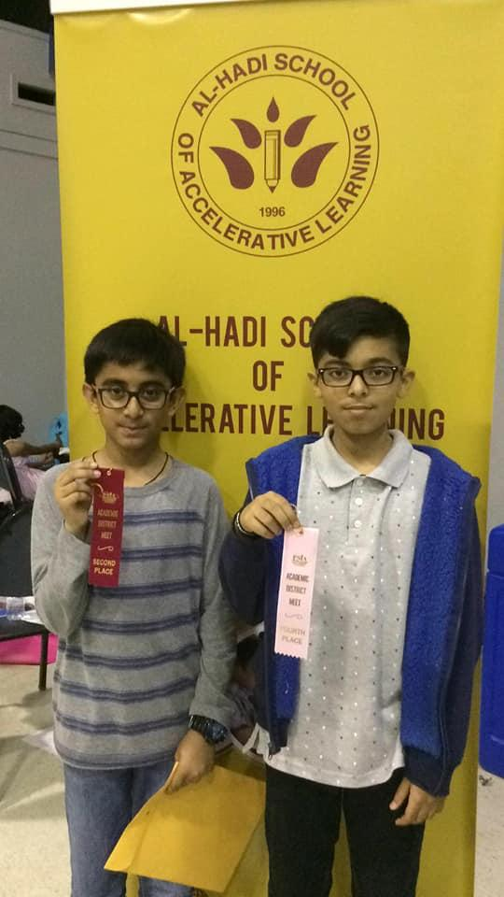
Based in Texas, PSIA is among the Most Comprehensive Extracurricular Academic Programs in the Nation. It holds competitions annually in districts throughout the state of Texas. District winners proceed to participate in the State Level competition in Fort Worth, TX.
Since 2005, Al-Hadi School has participated in this rigorous competition, and our students have won multiple awards at both District and State level.
HISTORY OF PSIA AT AL-HADI SCHOOL

Slide 3
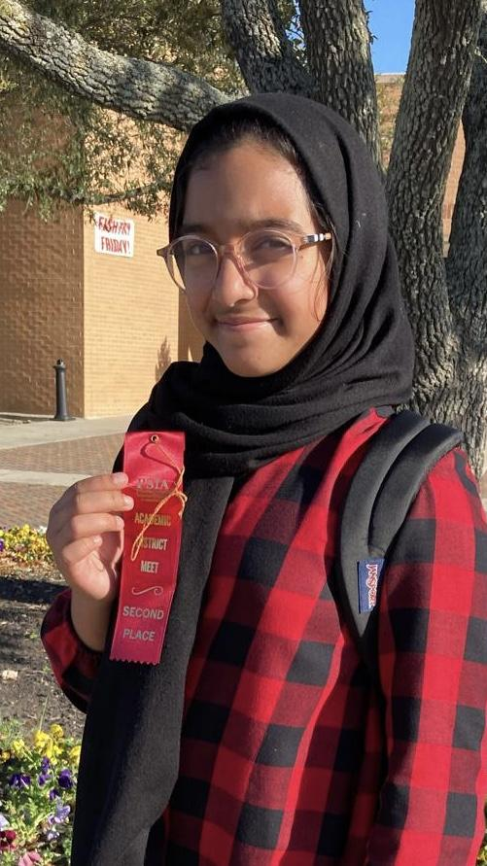
ABOUT PSIA
The PSIA Mission: To inspire private, parochial, charter, and homeschool student achievement through academic competition.
With 19 contest categories covering a wide range of disciplines, PSIA is an exciting opportunity for students in grades 1 through 8 to engage in academic competition with their peers throughout the state of Texas.
The academic competitive programs of Private Schools Interscholastic Association (PSIA) primarily motivate students to:
• find new excitement in learning;
• achieve a higher mastery level; and
• receive recognition and awards for academic excellence.
PSIA programs are designed to support the basic academic curricula and are easily implemented into daily studies to enrich academic skills.

Slide 4

COMPETITION LEVELS
THERE ARE THREE LEVELS OF THIS COMPETITION:
SCHOOL COMPETITION: Registration for PSIA begins in the month of May for the next school year. Students are given access to online resources to help them explore and learn different subjects throughout Summer. At the beginning of the new school year in August/September, weekly after-school coaching classes begin for all students. After thorough preparation through these coaching classes as well as extra preparation at home (guided by parents), students compete at school in mid February to determine the top two/three students from each grade and each subject (contest category). The top performing students advance to compete at the District Level competition.
DISTRICT COMPETITION: In the first week of March (usually the first Saturday of March), top performing students from Al-Hadi participate in a District Level competition. They compete against the top students from various other private schools in our district. The 2022-23 District Competition was at St Elizabeth Ann Seton School in Houston TX on March 4th. Winners at District go on to compete at State level.
STATE COMPETITION: Winners at District Level advance to the State Level competition held usually on the last Saturday of April. They compete against top winners from all over Texas. The last State competition was on April 29, 2023 at Texas Christian University, Fort Worth, TX.

Slide 5
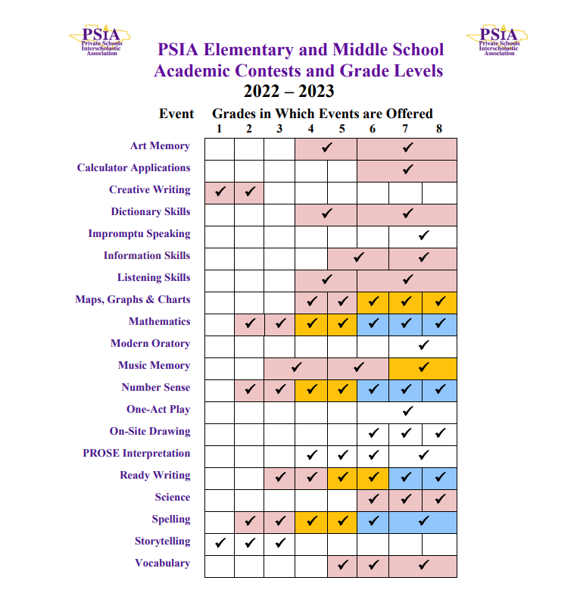
PSIA CONTESTS
Here’s a list of all contest categories students may register to participate in, according to grade level.
The next few slides share more information on each competition category (subject) offered at each grade level from 1 to 8.

Slide 6
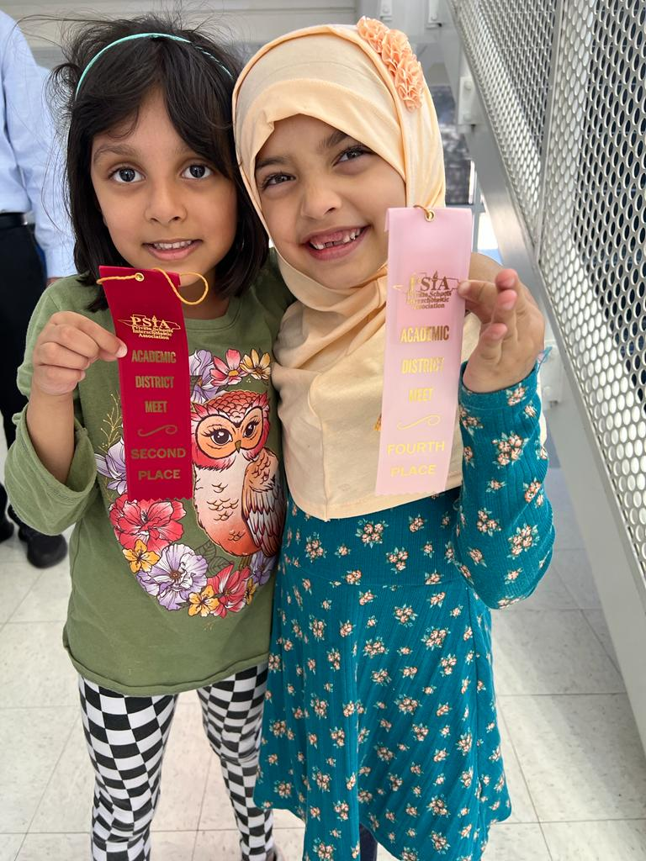
SUBJECTS AT EACH GRADE LEVEL
GRADE 1
Subjects (contest categories) available at this grade level:
Creative Writing: This event is designed to promote creativity and encourage writing skills at an early age. Using a prompt of 5 pictures, students have 30 minutes to create an original story based on the pictures.
Storytelling: Contestants hear a story that they retell before an audience. Presentations are evaluated on aspects of performance and overall effectiveness.

Slide 7
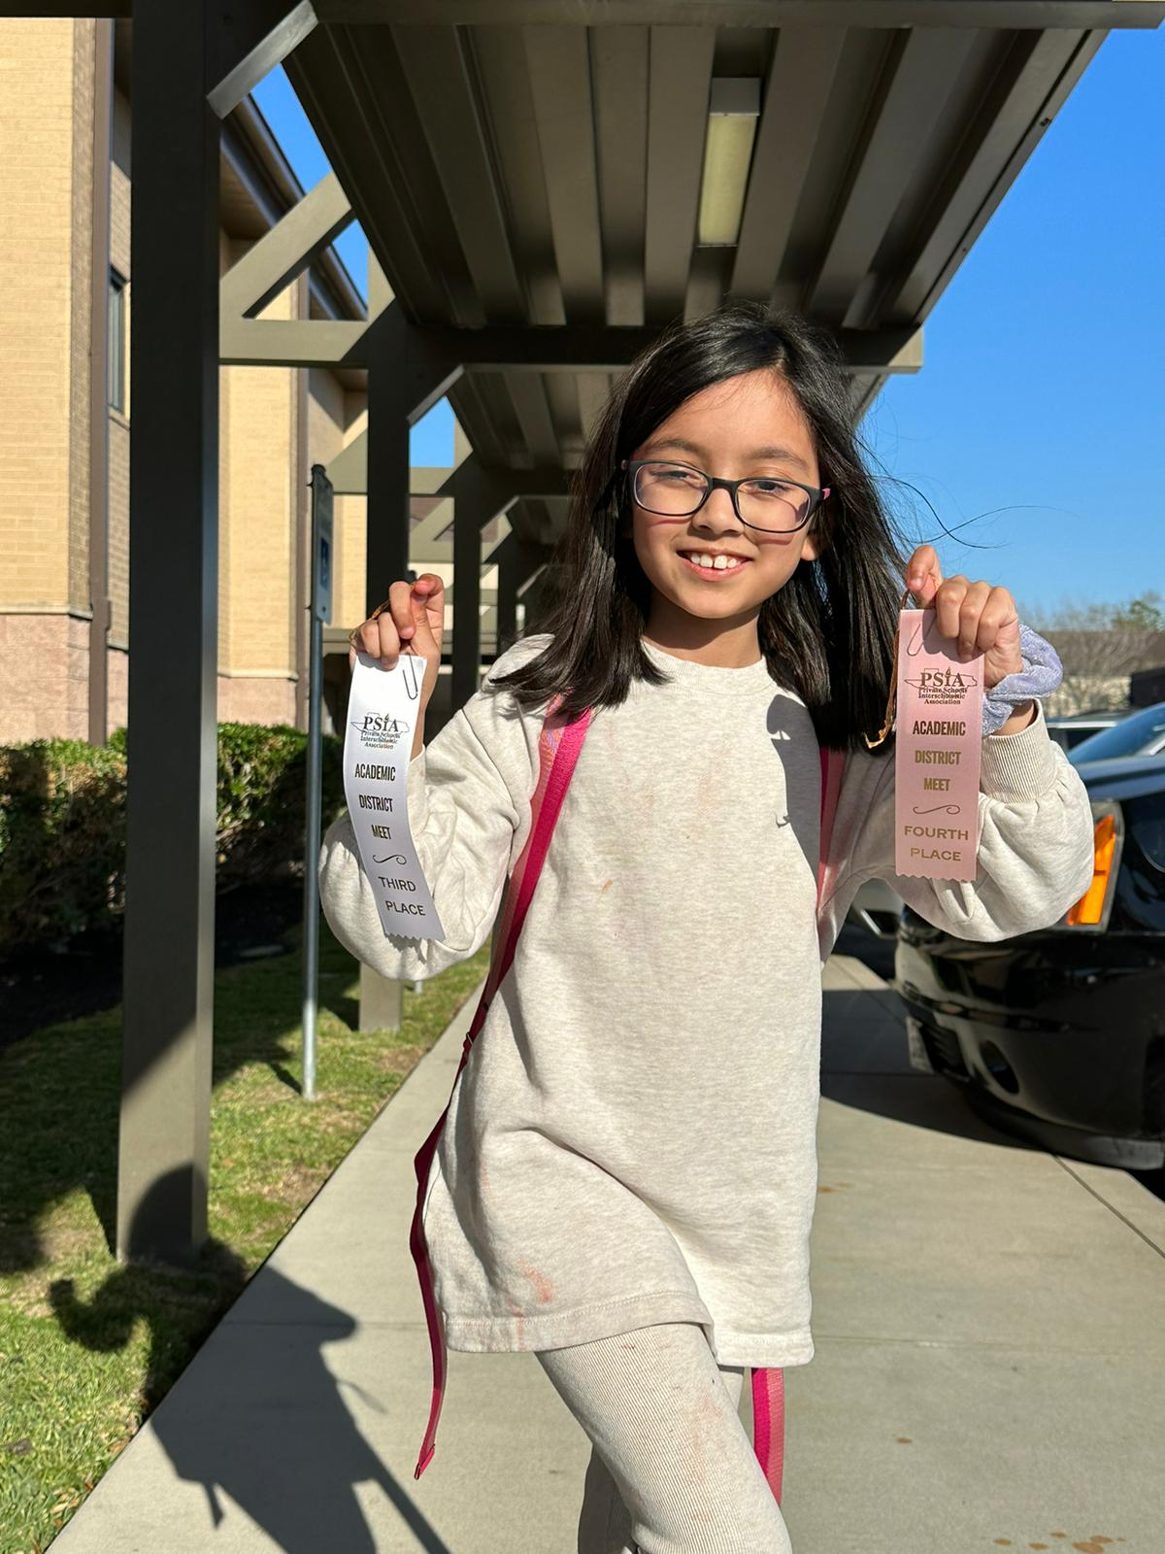
SUBJECTS AT EACH GRADE LEVEL
GRADE 2
Creative Writing: This event is designed to promote creativity and encourage writing skills at an early age. Using a prompt of 5 pictures, students have 30 minutes to create an original story based on the pictures.
Storytelling: Contestants hear a story that they retell before an audience. Presentations are evaluated on aspects of performance and overall effectiveness.
Mathematics: In a comprehensive, multiple choice, 30-minute math test, students are challenged beyond their grade levels in a variety of general math questions.
Number Sense (Mental Math): Contestants find high-speed solutions to math problems in this exciting and challenging 10-minute contest in mental mathematics.
Spelling: As spelling words are pronounced on an audio device, contestants may write or print each word. 25% of the test words come from the outside source dictionary; 75% come from the Spelling List.

Slide 8
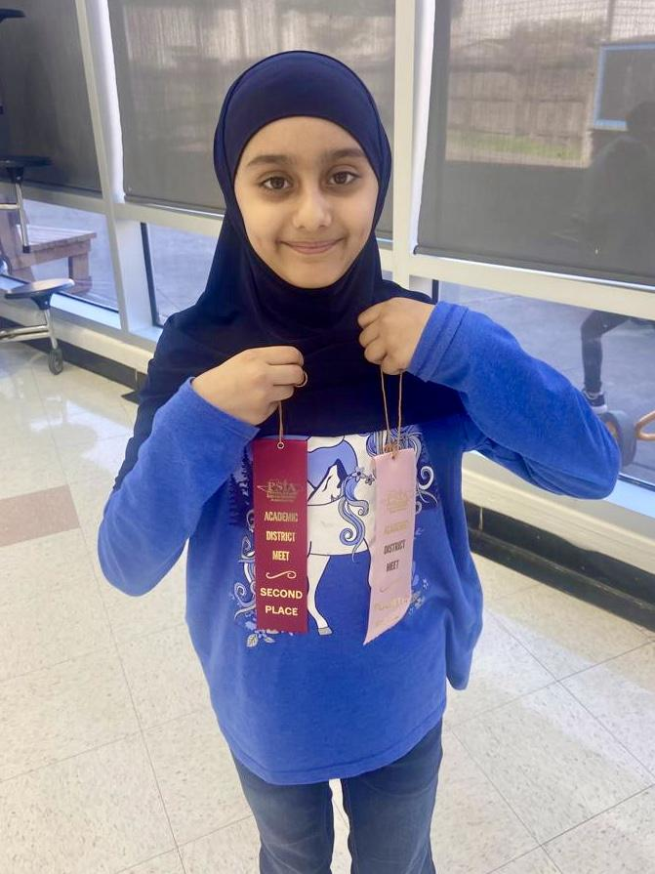
SUBJECTS AT EACH GRADE LEVEL
GRADE 3
Storytelling: Contestants hear a story that they retell before an audience. Presentations are evaluated on aspects of performance and overall effectiveness.
Mathematics: In a comprehensive, multiple choice, 30-minute math test, students are challenged beyond their grade levels in a variety of general math questions.
Number Sense (Mental Math): Contestants find high-speed solutions to math problems in this exciting and challenging 10-minute contest in mental mathematics.
Spelling: As spelling words are pronounced on an audio device, contestants may write or print each word. 25% of the test words come from the outside source dictionary; 75% come from the Spelling List.
Ready Writing: This event brings challenge for the gifted writer. Students are given a choice between two prompts. Each prompt defines the audience and provides or implies the purpose for writing.

Slide 9
SUBJECTS AT EACH GRADE LEVEL
GRADE 4
Mathematics: In a comprehensive, multiple choice, 30-minute math test, students are challenged beyond their grade levels in a variety of general math questions.
Number Sense (Mental Math): Contestants find high-speed solutions to math problems in this exciting and challenging 10-minute contest in mental mathematics.
Spelling: As spelling words are pronounced on an audio device, contestants may write or print each word. 25% of the test words come from the outside source dictionary; 75% come from the Spelling List.
Ready Writing: This event brings challenge for the gifted writer. Students are given a choice between two prompts. Each prompt defines the audience and provides or implies the purpose for writing.
Art Memory: Students are challenged to identify the artist and the work and answer questions about the art and the artists found in the Art Smart Bulletin, published every other year by TuneIn.
Dictionary Skills: Students use all elements of the dictionary (Merriam Webster Collegiate Dictionary, 11th edition) in the contest room, as they learn practical techniques for extracting and applying resource information.
Listening Skills: Good listening skills enhance any academic area, and the study materials are useful for all students. Contestants may take notes as they listen to the contest script on CD, and then use these notes as they answer objective test questions in 7 minutes.
Maps, Graphs & Charts (Geography): Tests include maps, graphs & charts and multiple-choice questions derived from 2018 or newer editions of the Nystrom Desk Atlas, which students bring to the contest. The grade 6-8 test includes additional atlas, geography, and Texas history questions.
Poetry Interpretation: Contestants select, prepare and read a literary PROSE selection within a six-minute time limit. Presentations are evaluated on aspects of performance and overall effectiveness.

Slide 10
SUBJECTS AT EACH GRADE LEVEL
GRADE 5
Mathematics: In a comprehensive, multiple choice, 30-minute math test, students are challenged beyond their grade levels in a variety of general math questions.
Number Sense (Mental Math): Contestants find high-speed solutions to math problems in this exciting and challenging 10-minute contest in mental mathematics.
Spelling: As spelling words are pronounced on an audio device, contestants may write or print each word. 25% of the test words come from the outside source dictionary; 75% come from the Spelling List.
Ready Writing: This event brings challenge for the gifted writer. Students are given a choice between two prompts. Each prompt defines the audience and provides or implies the purpose for writing.
Art Memory: Students are challenged to identify the artist and the work and answer questions about the art and the artists found in the Art Smart Bulletin, published every other year by TuneIn.
Dictionary Skills: Students use all elements of the dictionary (Merriam Webster Collegiate Dictionary, 11th edition) in the contest room, as they learn practical techniques for extracting and applying resource information.
Listening Skills: Good listening skills enhance any academic area, and the study materials are useful for all students. Contestants may take notes as they listen to the contest script on CD, and then use these notes as they answer objective test questions in 7 minutes.
Maps, Graphs & Charts (Geography): Tests include maps, graphs & charts and multiple-choice questions derived from 2018 or newer editions of the Nystrom Desk Atlas, which students bring to the contest. The grade 6-8 test includes additional atlas, geography, and Texas history questions.
Poetry Interpretation: Contestants select, prepare and read a literary PROSE selection within a six-minute time limit. Presentations are evaluated on aspects of performance and overall effectiveness.
Information Skills: Students use their internet devices to find answers on the internet for 24
questions in this 30-minute online research contest.
Vocabulary: SAT/PSAT preparation skills, including word usage, reading comprehension, and analogies, are honed through this challenging 30-item multiple-choice, 30-minute contest.

Slide 11
SUBJECTS AT EACH GRADE LEVEL
GRADE 6
Mathematics: In a comprehensive, multiple choice, 30-minute math test, students are challenged beyond their grade levels in a variety of general math questions.
Number Sense (Mental Math): Contestants find high-speed solutions to math problems in this exciting and challenging 10-minute contest in mental mathematics.
Spelling: As spelling words are pronounced on an audio device, contestants may write or print each word. 25% of the test words come from the outside source dictionary; 75% come from the Spelling List.
Ready Writing: This event brings challenge for the gifted writer. Students are given a choice between two prompts. Each prompt defines the audience and provides or implies the purpose for writing.
Art Memory: Students are challenged to identify the artist and the work and answer questions about the art and the artists found in the Art Smart Bulletin, published every other year by TuneIn.
Dictionary Skills: Students use all elements of the dictionary (Merriam Webster Collegiate Dictionary, 11th edition) in the contest room, as they learn practical techniques for extracting and applying resource information.
Listening Skills: Good listening skills enhance any academic area, and the study materials are useful for all students. Contestants may take notes as they listen to the contest script on CD, and then use these notes as they answer objective test questions in 7 minutes.
Maps, Graphs & Charts (Geography): Tests include maps, graphs & charts and multiple-choice questions derived from 2018 or newer editions of the Nystrom Desk Atlas, which students bring to the contest. The grade 6-8 test includes additional atlas, geography, and Texas history questions.
Poetry Interpretation: Contestants select, prepare and read a literary PROSE selection within a six-minute time limit. Presentations are evaluated on aspects of performance and overall effectiveness.
Information Skills: Students use their internet devices to find answers on the internet for 24
questions in this 30-minute online research contest. 2
Vocabulary: SAT/PSAT preparation skills, including word usage, reading comprehension, and analogies, are honed through this challenging 30-item multiple-choice, 30-minute contest.
Calculator Applications (Pre-Engineering): This 30-minute contest develops mathematical reasoning and requires application of problem-solving skills toward realistic problems. Any calculator may be used in competition.
Science: Earth, Life and Physical Science information found in current textbooks, plus items from current science publications list, are tested in this 30-minute, multiple choice contest, which usually consists of 50 test questions.
On-Site Drawing: Contestants have 45 minutes to produce a rendering of a still life display (4 to 7 objects) on multi-use drawing paper using any media. Art works are judged by qualified artists and displayed in an art show.

Slide 12
SUBJECTS OFFERED FOR GRADES 7 & 8
Mathematics: In a comprehensive, multiple choice, 30-minute math test, students are challenged beyond their grade levels in a variety of general math questions.
Number Sense (Mental Math): Contestants find high-speed solutions to math problems in this exciting and challenging 10-minute contest in mental mathematics.
Spelling: As spelling words are pronounced on an audio device, contestants may write or print each word. 25% of the test words come from the outside source dictionary; 75% come from the Spelling List.
Ready Writing: This event brings challenge for the gifted writer. Students are given a choice between two prompts. Each prompt defines the audience and provides or implies the purpose for writing.
Art Memory: Students are challenged to identify the artist and the work and answer questions about the art and the artists found in the Art Smart Bulletin, published every other year by TuneIn.
Dictionary Skills: Students use all elements of the dictionary (Merriam Webster Collegiate Dictionary, 11th edition) in the contest room, as they learn practical techniques for extracting and applying resource information.
Listening Skills: Good listening skills enhance any academic area, and the study materials are useful for all students. Contestants may take notes as they listen to the contest script on CD, and then use these notes as they answer objective test questions in 7 minutes.
Maps, Graphs & Charts (Geography): Tests include maps, graphs & charts, & multiple-choice questions derived from 2018 or newer editions of the Nystrom Desk Atlas, which students bring to the contest. The grade 6-8 test includes additional atlas, geography, & Texas history questions.
Poetry Interpretation: Contestants select, prepare and read a literary PROSE selection within a six-minute time limit. Presentations are evaluated on aspects of performance and overall effectiveness.
Information Skills: Students use their internet devices to find answers on the internet for 24 questions in this 30-minute online research contest.
Vocabulary: SAT/PSAT preparation skills, including word usage, reading comprehension, and analogies, are honed through this challenging 30-item multiple-choice, 30-minute contest.
Calculator Applications (Pre-Engineering): This 30-minute contest develops mathematical reasoning and requires application of problem-solving skills toward realistic problems. Any calculator may be used in competition.
Science: Earth, Life and Physical Science information found in current textbooks, plus items from current science publications list, are tested in this 30-minute, multiple choice contest, which usually consists of 50 test questions.
On-Site Drawing: Contestants have 45 minutes to produce a rendering of a still life display (4 to 7 objects) on multi-use drawing paper using any media. Art works are judged by qualified artists and displayed in an art show.
Impromptu Speaking: Students in grades 7 and 8 combined are challenged to think quickly and communicate effectively. They organize their thoughts on a topic for three minutes, then speak for five or fewer minutes without notes.
Modern Oratory: A challenge in writing and speaking, grade 7 & 8 students prepare a short original speech to examine the pros/cons of an issue and defend their points of view, incorporating a variety of skills. Contestants take a stand on only one side of the issue.

Slide 13
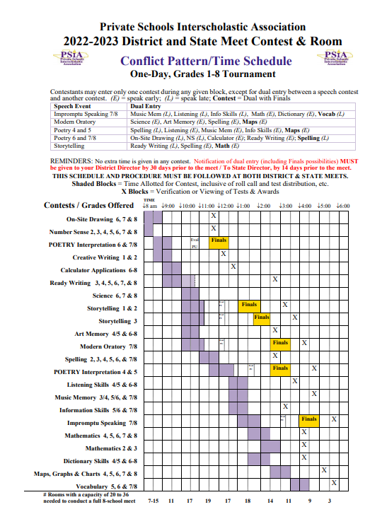
CONTEST SCHEDULE
All PSIA competitions are held in a single day.
Since some contests take place simultaneously and others overlap in timing, students will be asked to choose between subjects while registering for the competition.
The next slides show contest timings along with schedule conflicts in detail.
Please review this information before selecting subjects your child would like to participate in.

Slide 14
CONTEST SCHEDULE BY GRADE LEVEL
The schedule is usually the same for both District and State Level Contests
GRADE 1
8:30am - 9:30am | Creative Writing
10:00am - 11:15am | Storytelling PRELIMINARY ROUND
1:00pm - 2:00pm | Storytelling FINAL ROUND

Slide 15
CONTEST SCHEDULE BY GRADE LEVEL
The schedule is usually the same for both District and State Level Contests
GRADE 2
8:00am - 8:30am | Number Sense
8:30am - 9:30am | Creative Writing
10:00am - 11:15am 11:00am - 12:00pm | Storytelling PRELIMINARY ROUND OR Spelling
1:00pm - 2:00pm | Storytelling FINAL ROUND
2:00pm - 3:00pm | Math
NOTE: At registration time, you must choose between signing up for either Storytelling or Spelling, since there is an overlap of timing at the contest.
There are ways to request dual entry scheduling, but it causes unnecessary stress for children.

Slide 16
CONTEST SCHEDULE BY GRADE LEVEL
The schedule is usually the same for both District and State Level Contests
GRADE 3
8:00am - 8:30am | Number Sense
9:00am - 10:45am 10:00am - 11:15am | Ready Writing OR Storytelling PRELIMINARY ROUND
10:00am - 11:15am 11:00am - 12:00pm | Storytelling PRELIMINARY ROUND OR Spelling
1:30pm - 2:30pm | Storytelling FINAL ROUND
2:00pm - 3:00pm | Math
NOTE: Students who participate in Storytelling, should not participate in Ready Writing and Spelling, due to an overlap in contest timing.
There are ways to request dual entry scheduling, but it causes undue stress for children.

Slide 17
CONTEST SCHEDULE BY GRADE LEVEL
The schedule is usually the same for both District and State Level Contests
GRADE 4
8:00am - 8:30am | Number Sense
9:00am - 10:45am 10:00am - 11:00am | Ready Writing OR Art Memory
11:00am - 12:00pm 11:30am - 12:45pm | Spelling OR Poetry Interpretation PRELIM
11:30am - 12:45pm 12:30pm - 1:30pm | Poetry Interpretation PRELIM OR Listening Skills
1:30pm - 2:30pm 1:30pm - 2:30pm | Math OR Dictionary Skills
2:30pm - 3:30pm 2:30pm - 3:30pm | Poetry Interpretation FINAL OR Maps Graphs Charts
NOTE
DUE TO SCHEDULING CONFLICTS, STUDENTS CHOOSE BETWEEN:
Ready Writing & Art Memory
Poetry Interpretation & Spelling
Poetry Interpretation & Listening Skills
Poetry Interpretation & Maps Graphs Charts
Math & Dictionary Skills

Slide 18
CONTEST SCHEDULE BY GRADE LEVEL
The schedule is usually the same for both District and State Level Contests
GRADE 5
8:00am - 8:30am | Number Sense
9:00am - 10:45am 10:00am - 11:00am | Ready Writing OR Art Memory
11:00am - 12:00pm 11:30am - 12:45pm | Spelling OR Poetry Interpretation PRELIM
11:30am - 12:45pm 12:30pm - 1:30pm 12:30pm - 1:30pm | Poetry Interpretation PRELIM OR Listening Skills OR Information Skills
1:30pm - 2:30pm 1:30pm - 2:30pm | Math OR Dictionary Skills
2:30pm - 3:30pm 2:30pm - 3:30pm | Poetry Interpretation FINAL OR Maps Graphs Charts
3:30pm - 4:30pm | Vocabulary
NOTE
DUE TO SCHEDULING CONFLICTS, STUDENTS CHOOSE BETWEEN:
Ready Writing & Art Memory
Poetry Interpretation & Spelling
Poetry Interpretation & Listening Skills
Poetry Interpretation & Maps Graphs Charts
Listening Skills & Information Skills
Math & Dictionary Skills

Slide 19
CONTEST SCHEDULE BY GRADE LEVEL
The schedule is usually the same for both District and State Level Contests
GRADE 6
8:00am - 9:00am 8:00am - 8:30am | Onsite Drawing OR Number Sense
8:00am - 9:00am 8:30am - 9:30am | Onsite Drawing OR Poetry Interpretation PRELIM
9:00am - 10:00am 8:30am - 9:30am | Calculator Applications OR Poetry Interpretation PRELIM
9:00am - 10:45am 8:30am - 9:30am | Ready Writing OR Poetry Interpretation PRELIM
9:00am - 10:00am 9:00am - 10:45am | Calculator Applications OR Ready Writing
9:00am - 10:45am 10:00am - 11:00am | Ready Writing OR Science
9:00am - 10:45am 10:00am - 11:00am | Ready Writing OR Art Memory
10:00am - 11:00am 10:00am - 11:00am | Science OR Art Memory
11:00am - 12:00pm 11:30pm - 12:30pm | Spelling OR Poetry Interpretation FINAL
12:30pm - 1:30pm 12:30pm - 1:30pm | Information Skills OR Listening Skills
1:30pm - 2:30pm 1:30pm - 2:30pm | Math OR Dictionary Skills
2:30pm - 3:30pm | Maps Graphs Charts
3:30pm - 4:30pm | Vocabulary
DUE TO SCHEDULING CONFLICTS, STUDENTS MUST CHOOSE BETWEEN THE FOLLOWING SUBJECTS:
Onsite Drawing & Number Sense
Poetry Interpretation & Spelling
Poetry Interpretation & Onsite Drawing
Poetry Interpretation & Calculator Applications
Poetry Interpretation & Ready Writing
Ready Writing & Calculator Applications
Ready Writing & Science
Ready Writing & Art Memory
Science & Art Memory
Information Skills & Listening Skills
Math & Dictionary Skills

Slide 20
CONTEST SCHEDULE BY GRADE LEVEL
The schedule is usually the same for both District and State Level Contests
DUE TO SCHEDULING CONFLICTS, STUDENTS MUST CHOOSE BETWEEN THE SUBJECTS OVERLAPPING IN TIMING
GRADES 7 & 8
8:00am - 9:00am 8:00am - 8:30am | Onsite Drawing OR Number Sense
8:00am - 9:00am 8:30am - 9:30am | Onsite Drawing OR Poetry Interpretation PRELIM
9:00am - 10:00am 8:30am - 9:30am | Calculator Applications OR Poetry Interpretation PRELIM
9:00am - 10:45am 8:30am - 9:30am | Ready Writing OR Poetry Interpretation PRELIM
9:00am - 10:45am 10:00am -11:15am | Ready Writing OR Modern Oratory PRELIM
9:00am - 10:00am 9:00am - 10:45am | Calculator Applications OR Ready Writing
9:00am - 10:45am 10:00am - 11:00am | Ready Writing OR Science
3:30pm - 4:30pm 4:00pm - 5:00pm | Vocabulary OR Impromptu Speaking FINAL
9:00am - 10:45am 10:00am - 11:00am | Ready Writing OR Art Memory
10:00am - 11:00am 10:00am - 11:00am 10:00am - 11:15am | Science OR Art Memory OR Modern Oratory PRELIM
11:00am - 12:00pm 11:30pm - 12:30pm | Spelling OR Poetry Interpretation FINAL
11:00am - 12:00pm 10:00am - 11:15am | Spelling OR Modern Oratory PRELIM
12:30pm - 1:30pm 12:30pm - 1:30pm 1:00pm - 2:00pm | Information Skills OR Listening Skills OR Impromptu Speaking
1:30pm - 2:30pm 1:30pm - 2:30pm | Math OR Dictionary Skills
2:30pm - 3:30pm 2:30pm - 3:30pm | Modern Oratory FINAL OR Maps Graphs Charts

Slide 21
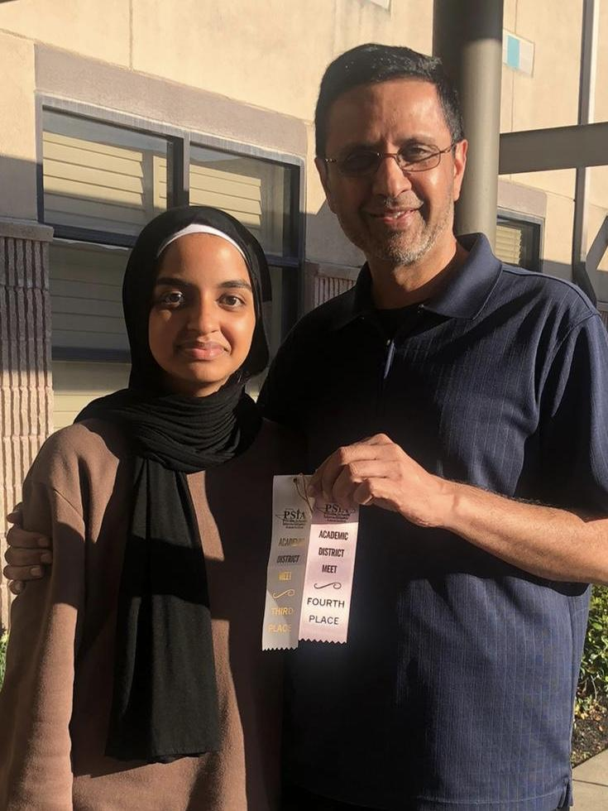
PSIA STUDY MATERIALS
To help you prepare your child for the contests, study materials and practice tests will be available for you online after your registration is complete in the month of May. It would be ideal for you to coach your child at home during the summer vacation. This way your child will get a head start on learning important skills.
When school reopens in Fall (August/September), weekly after school classes will be organized to coach your child. You may enroll your child in these classes or continue coaching at home. Ideally, you can choose to do both.
You can access the after school coaching schedule on our website at:
https://www.alhadi.com/student-life/psia.html

Slide 22
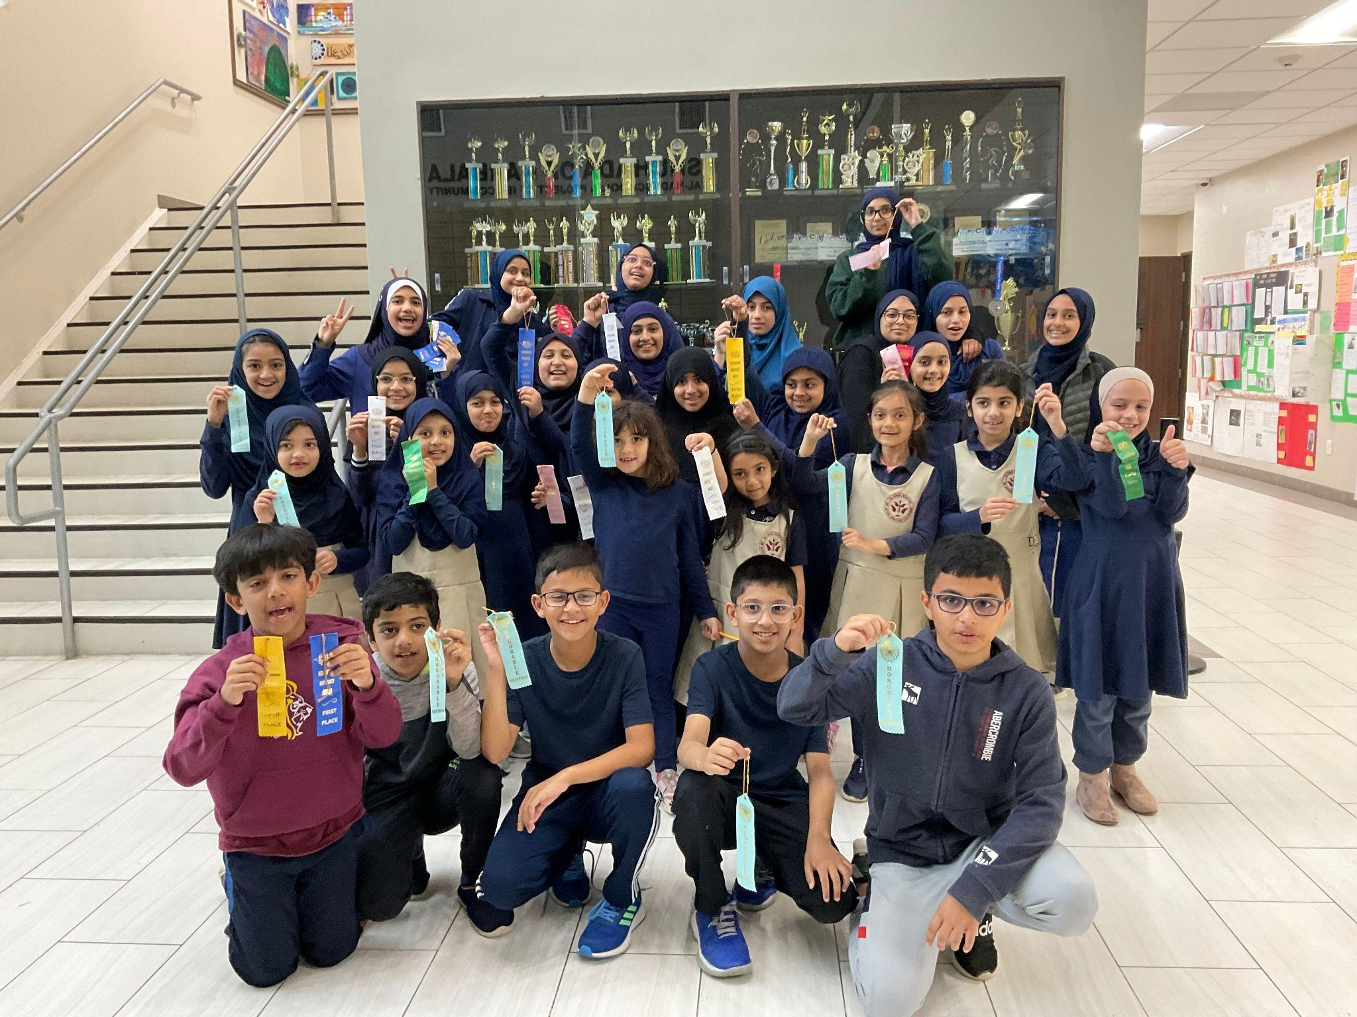
PSIA REGISTRATION
Please fill out the registration form within ten days of receiving the signup email.
There is a $15 flat registration fee, that goes towards purchasing study materials and our membership in the PSIA program.
Ideally, it is best to sign up for two to maximum three subjects (contest categories). Please try to avoid signing up for too many subjects.

Slide 23
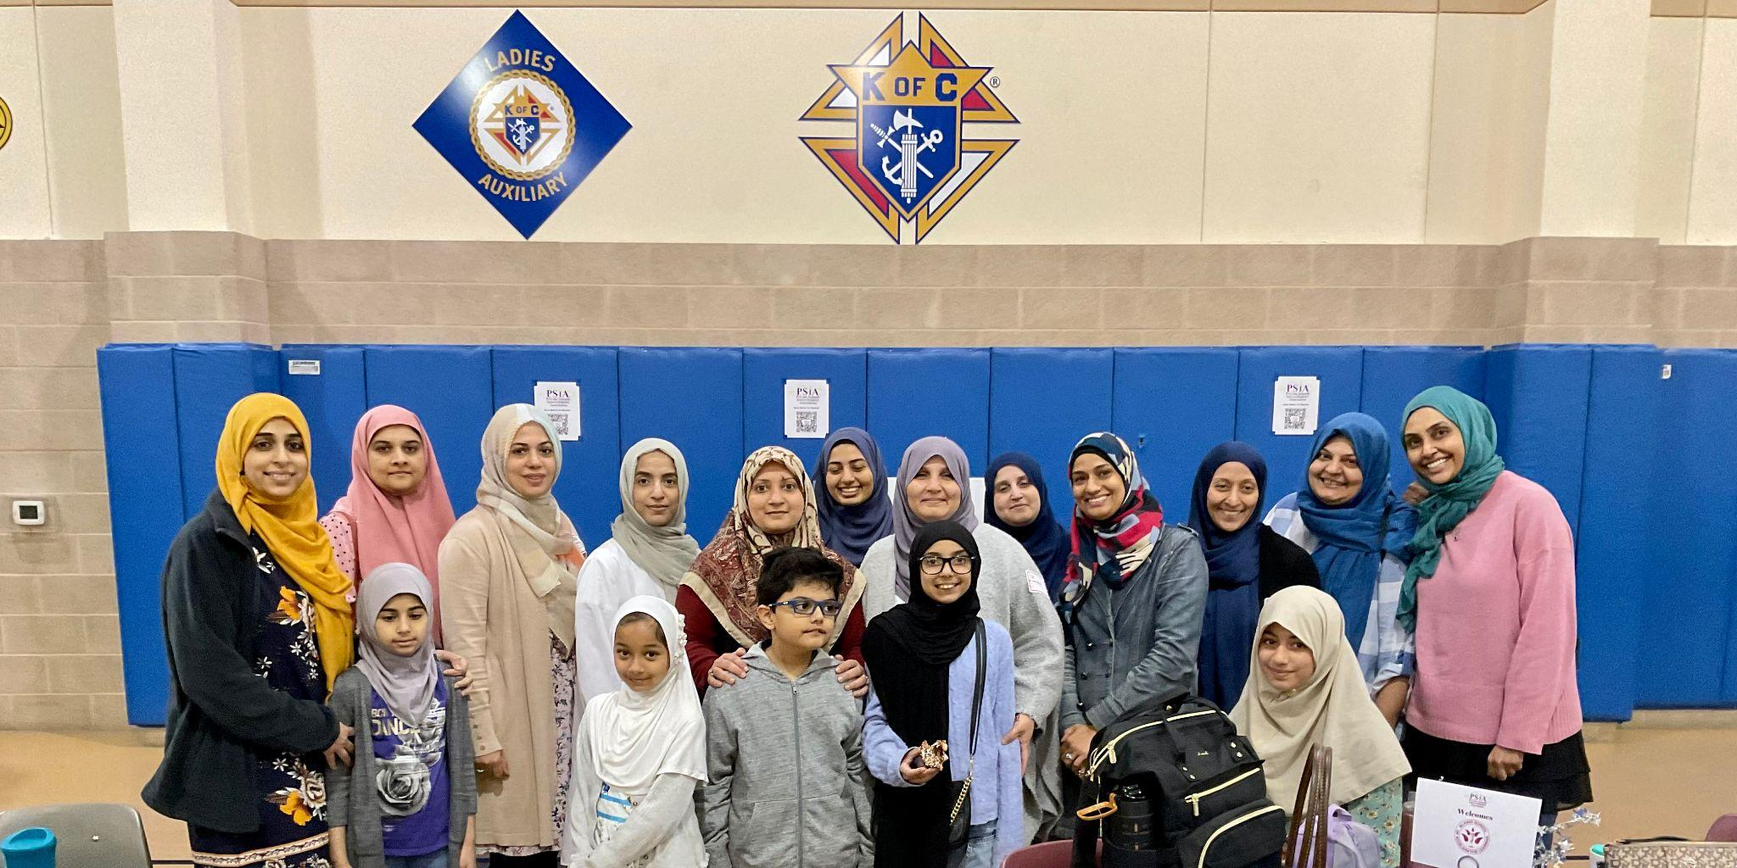
PARENT VOLUNTEERS
PSIA is a volunteer based organization. For each child enrolled, at least one parent/guardian/adult family member will be required to volunteer at the contest.
Volunteer help is needed at both District and State contests.
You can choose to volunteer in any of the following categories:
Register as a Contest Director
Register as an Assistant Contest Director
Help with Grading papers at the Competition
Hall Monitor (making sure the hallways are quiet during contests)
Contest Monitor
Carpooling students (who have permission to participate but have difficulty in reaching the campus).
Arranging snacks & food for our student contestants. It’s a full day of contests.
Overseeing/monitoring students while their parents volunteer at other contests.
Escorting students to contests from a central location within the premises.
Judge for speech contests
Judge writing contests
Thank you for making a difference!

Slide 24

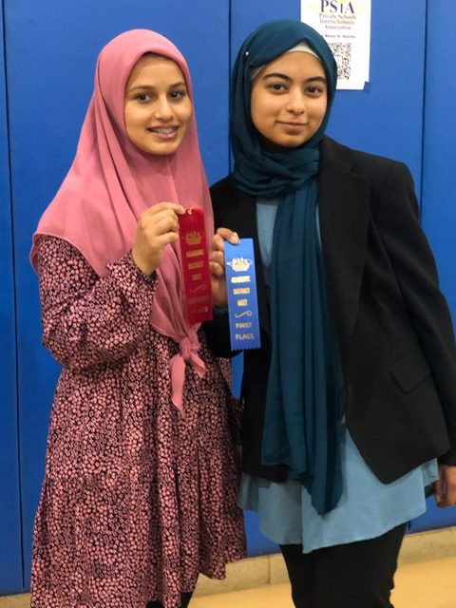
For more information, please visit:
https://www.psiaacademics.org/
https://www.alhadi.com/student-life/psia.html
Please contact the Student Life Coordinator for any questions at: sshahnawaz@alhadi.com

